Slide 1



Hardware
Fellowship
Day 2

Slide 2

Day 1 Recap
Breadboards
LEDs
Resistor
Transistor
LDR
Basic Arduino Functions

Slide 3

Day 2 Overview
Review of Basic Arduino Functions
Switch Bouncing and Debouncing
Ultrasonic Sensor
Interfacing Ultrasonic Sensor with Arduino
LCD Screen
Interfacing LCD Screen with Arduino

Slide 4
Review Of Functions in Arduino
Digital I/O
pinMode()
Sets pin as either Input or Output
Syntax:
pinMode(pin, mode)
digitalRead()
Reads value from a specified digital pin
Syntax:
digitalRead(pin)
digitalWrite()
Writes value to a specified digital pin
Syntax:
digitalWrite(pin)
Note: delay() function is used to stay in wait state before moving onto the next line of code. Takes numbers as arguments that represent time in milliseconds(ms).

Slide 5
Review Of Functions in Arduino
analogRead()
Reads value from specified analog pin.
Analog pin is denoted with 'A' in the front of pin name.
Syntax:
analogRead(pin)
analogWrite()
Writes analog value to a specified pin
Syntax:
analogWrite(pin, value)

Slide 6
Using Serial Monitor
Use Serial.begin() inside setup() to set the baud rate.
Use Serial.print() to print values in Serial Monitor

Slide 7
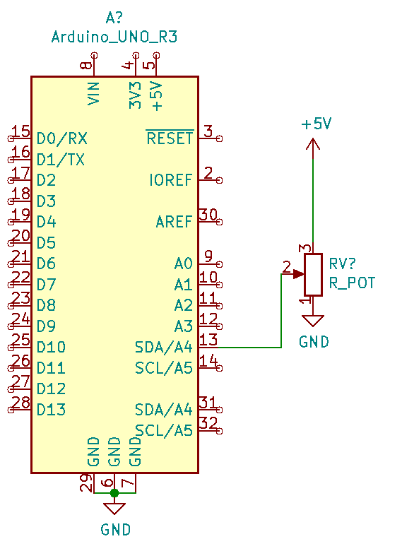
Analog Read from Potentiometer

Slide 8
Code:
void setup()
{
pinMode(A4, INPUT);
Serial.begin(9600);
}
void loop()
{
int val = analogRead(A4);
float voltage = val * (5.0/1023.0);
Serial.println(voltage);
delay(1000); // Wait for 1000 millisecond(s)
}

Slide 9
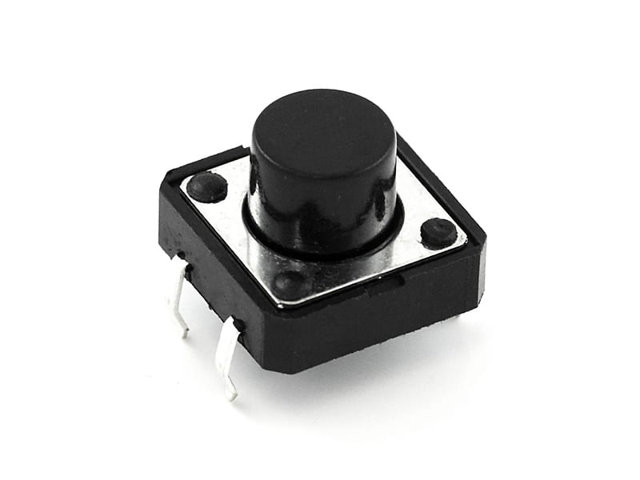
Using Switches

Slide 10
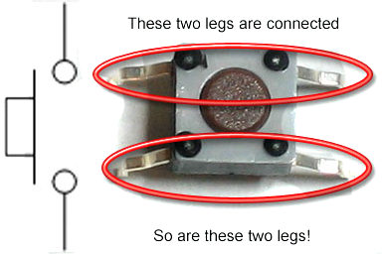

Slide 11
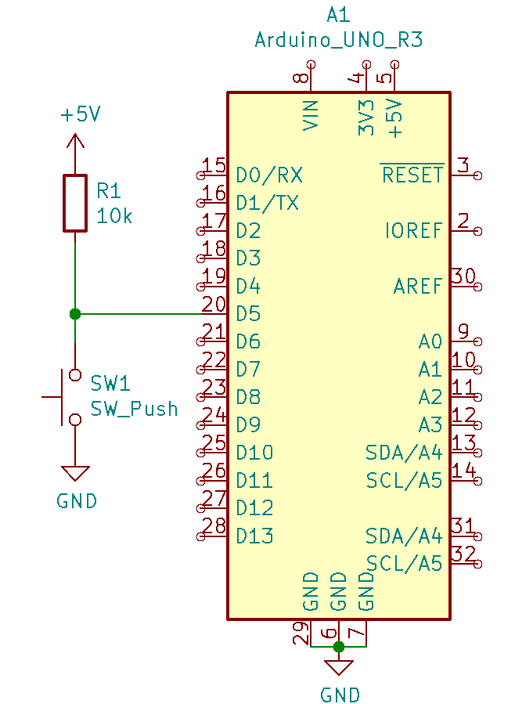
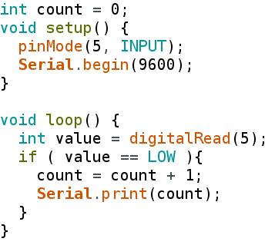
Input from a Switch

Slide 12
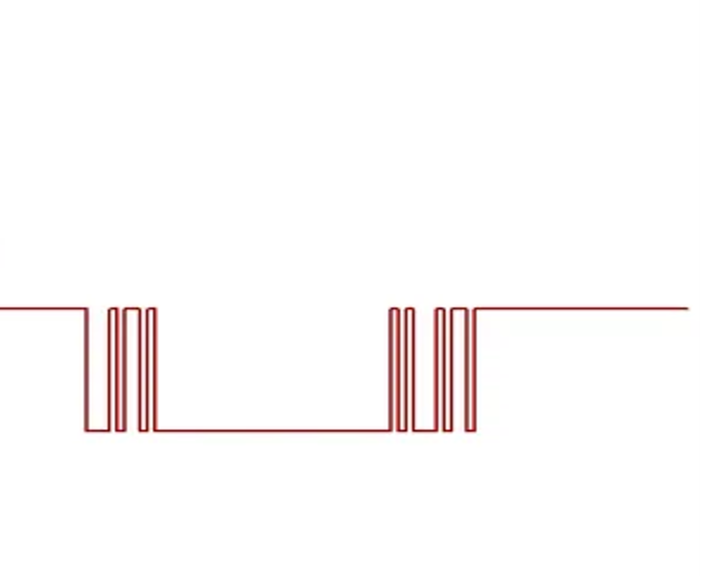
Switch Bouncing
User Presses Switch
User Releases Switch
Switch is in not
Pressed state

Slide 13
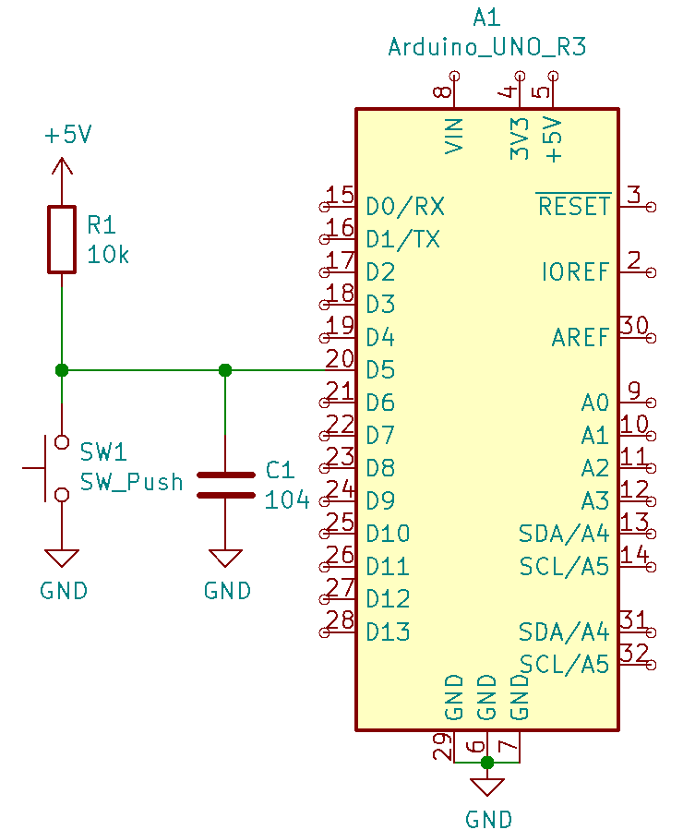
DEBOUNCING USING CAPACITOR

Slide 14
Software Debouncing
Debouncing using code
Take two consecutive readings of switch at a fixed interval
If both readings are the same, switch is in stable state.
If both readings are different, state of the switch has changed.

Slide 15
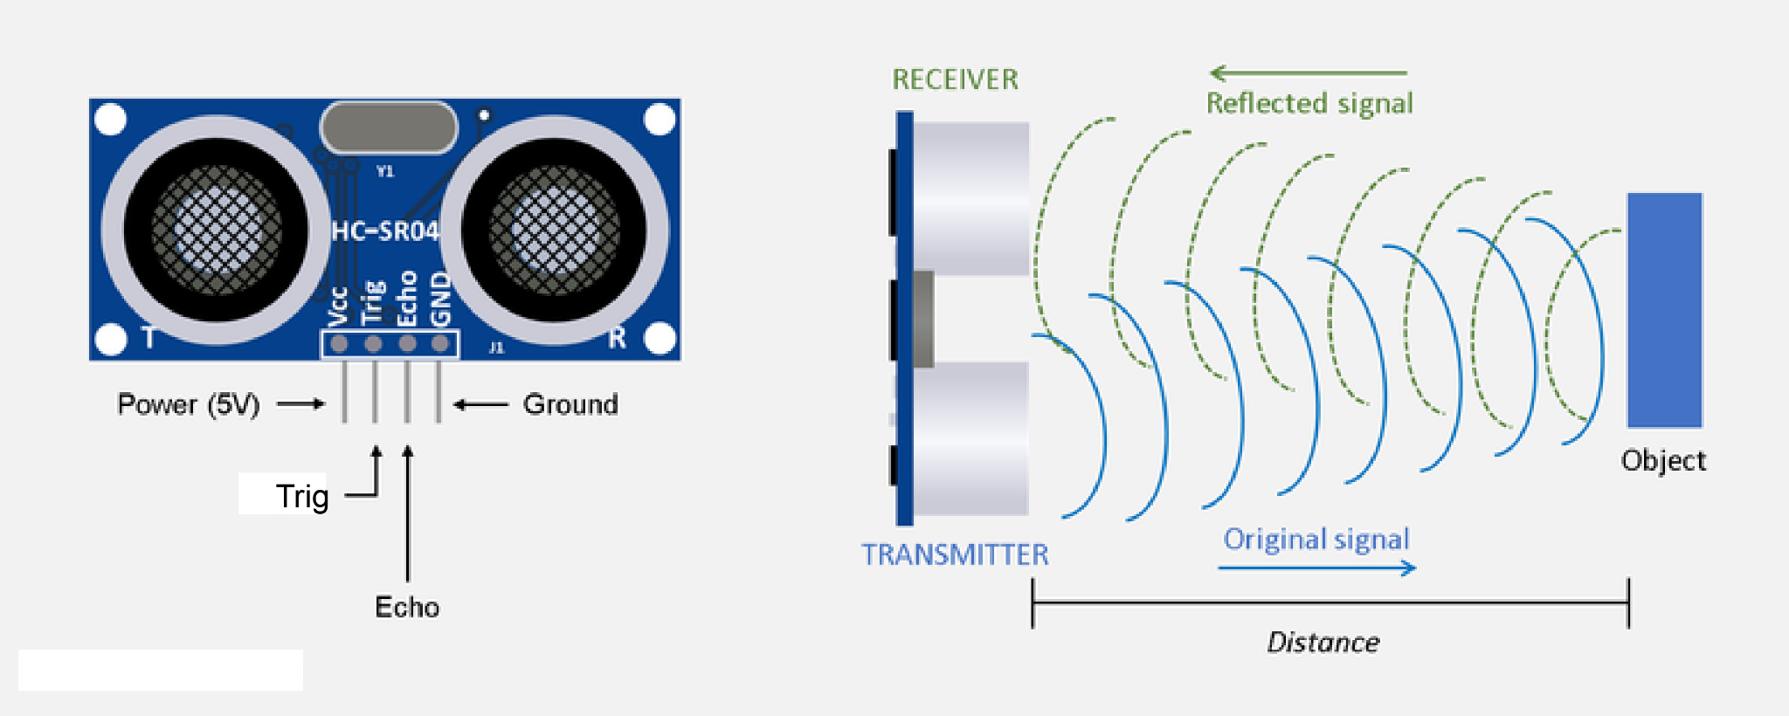
ULTRASONIC SENSOR

Slide 16
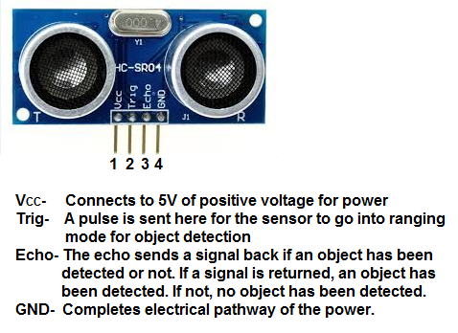

Slide 17
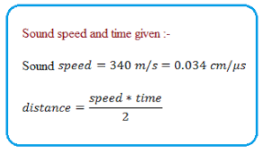
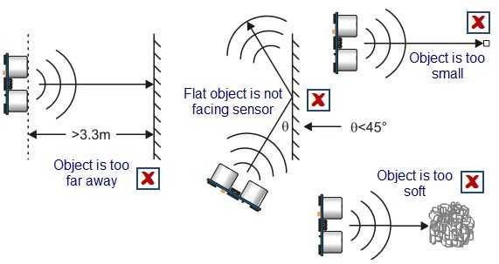

Slide 18
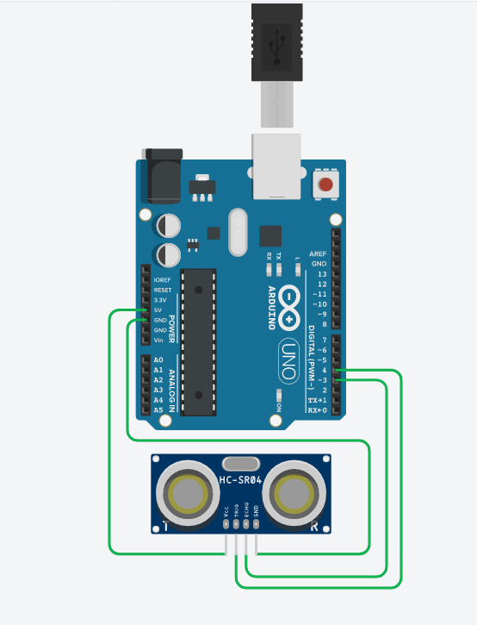
Interfacing Ultrasonic (HC-SR04) Sensor with Arduino
Echo and Trigger Pin of the ultrasonic sensor can be connected to any of the digital pins!

Slide 19
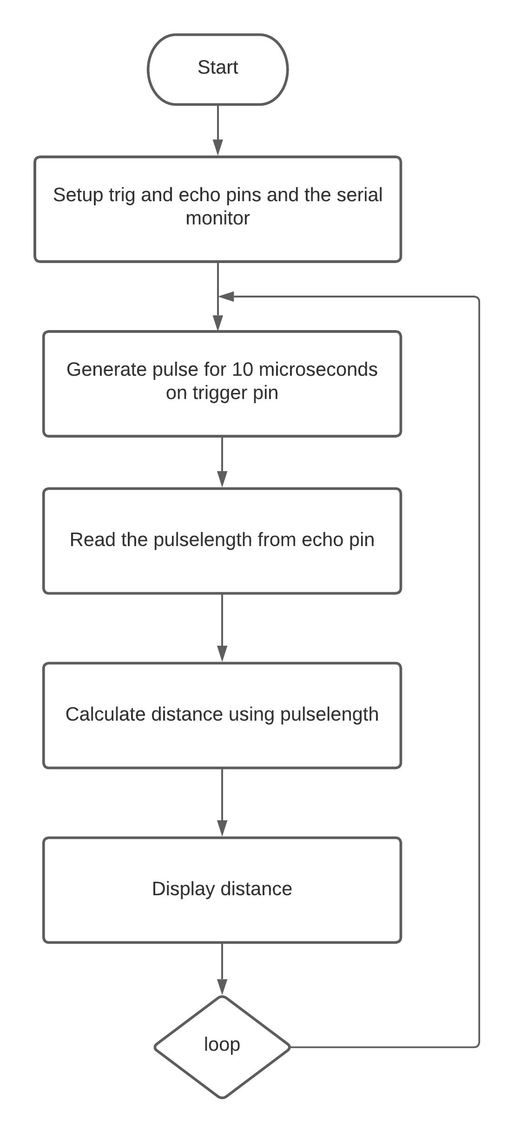
Interfacing Ultrasonic (HC-SR04) Sensor with Arduino

Slide 20
Interfacing Ultrasonic (HC-SR04) Sensor with Arduino
long duration;
int distance;
int Trig_PIN = 5;
int Echo_PIN = 4;
void setup() {
pinMode(Trig_PIN, OUTPUT);
pinMode(Echo_PIN, INPUT);
Serial.begin(9600);
}
void loop() {
digitalWrite(Trig_PIN, LOW);
delayMicroseconds(2);
digitalWrite(Trig_PIN, HIGH);
delayMicroseconds(10);
digitalWrite(Trig_PIN, LOW);
duration = pulseIn(Echo_PIN, HIGH);
distance = duration * 0.034 / 2;
Serial.println("Distance: ");
Serial.print(distance);
Serial.println(" cm");
}

Slide 21
LIBRARIES IN ARDUINO
Library refers to a collection of files, programs, routines, scripts, or functions that can be referenced in the programming code.
Program code that has already been written
In concrete terms, library is a suite of helper functions which another program can make use of, without having to write each one ourselves.
Arduino has many third-party libraries
Greatly helps the programmer to simply use a certain component or module without the necessity to have detailed knowledge about the working of the module.
This is one of the main reasons Arduino is one of the most popular microcontroller boards available in the market.
In today's session, we will use a library named "LiquidCrystal.h", that provides the functions to run a LCD display without the need to know the detailed construction of LCD Display.

Slide 22
IMPORTING LIBRARIES IN ARDUINO IDE
Open the Arduino IDE and Navigate to the menu bar.
From there go to Sketch>Include Library.
If you haven't installed the library yet, go to "Manage Libraries" or "Add .ZIP Library" and install the library.
The library now appears in the Menu.
You will notice that this also adds a folder in your hard drive's file tree.

Slide 23
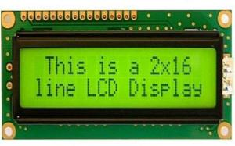
LCD DISPLAY

Slide 24
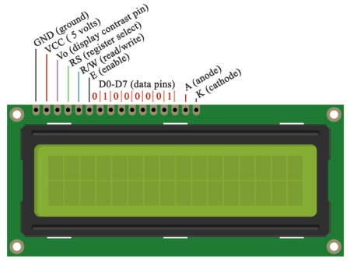
PINOUT OF LCD DISPLAY

Slide 25
PINOUT OF LCD DISPLAY
Pin1(GND):Ground pin of the LCD module.
Pin2(VCC): Power to LCD module (+5V supply is given to this pin)
Pin3(Vo):Contrast adjustment pin. This is done by connecting the ends of a 10K potentiometer to +5V and ground and then connecting the slider pin to the VEE pin. The voltage at the VEE pin defines the contrast. The normal setting is between 0.4 and 0.9V.
Pin4(RS):Register select pin .The JHD162A has two registers namely command register and data register. Logic HIGH at RS pin selects data register and logic LOW at RS pin selects command register. If we make the RS pin HIGH and feed an input to the data lines (DB0 to DB7), this input will be treated as data to display on LCD screen. If we make the RS pin LOW and feed an input to the data lines, then this will be treated as a command ( a command to be written to LCD controller – like positioning cursor or clear screen or scroll).
Pin5(R/W): Read/Write modes. This pin is used for selecting between read and write modes. Logic HIGH at this pin activates read mode and logic LOW at this pin activates write mode.
Pin6(E): This pin is meant for enabling the LCD module. A HIGH to LOW signal at this pin will enable the module.
Pin7(DB0) to Pin14(DB7): These are data pins. The commands and data are fed to the LCD module though these pins.
Pin15(LED+): Anode of the back light LED. When operated on 5V, a 560-ohm resistor should be connected in series to this pin. In arduino based projects the back light LED can be powered from the 3.3V source on the Arduino board.
Pin16(LED-): Cathode of the back light LED.

Slide 26
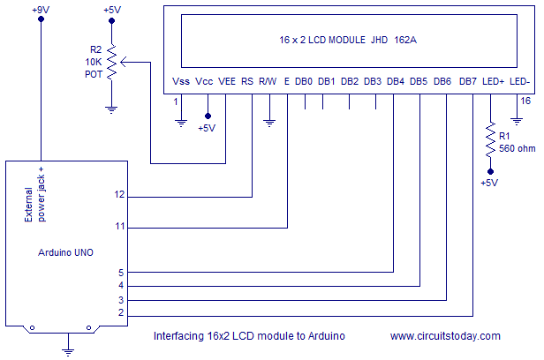
INTERFACING LCD DISPLAY WITH ARDUINO

Slide 27
Basic functions used to interface LCD with Arduino
begin()
Initializes the interface to the LCD screen and specifies the dimensions (width and height) of the display.
Needs to be called before any other LCD library commands.
Syntax:
lcd.begin(cols, rows)
clear()
Clears the LCD screen and positions the cursor in the upper-left corner.
Syntax:
lcd.clear()

Slide 28
Basic functions used to interface LCD with Arduino
setCursor()
Position the LCD cursor; that is, set the location at which subsequent text written to the LCD will be displayed.
Syntax:
lcd.setCursor(cols, rows)
print()
Prints text to the LCD.
Syntax:
lcd.print(data)

Slide 29
SOURCE CODE
#include <LiquidCrystal.h>
LiquidCrystal lcd(12, 11, 5, 4, 3, 2);
void setup() {
lcd.begin(16,2);
lcd.print("hello, world!");
}
void loop() {
}

Slide 30
Task
Read distance values from the ultrasonic sensor and display it in LCD.

Slide 31
ASSIGNMENT
CREATE A SYSTEM WHERE AN ULTRASONIC SENSOR DETECTS THE OBSTACLE INCOMING AND THE USER GETS NOTIFIED THROUGH LCD DISPLAY

